Slide 1



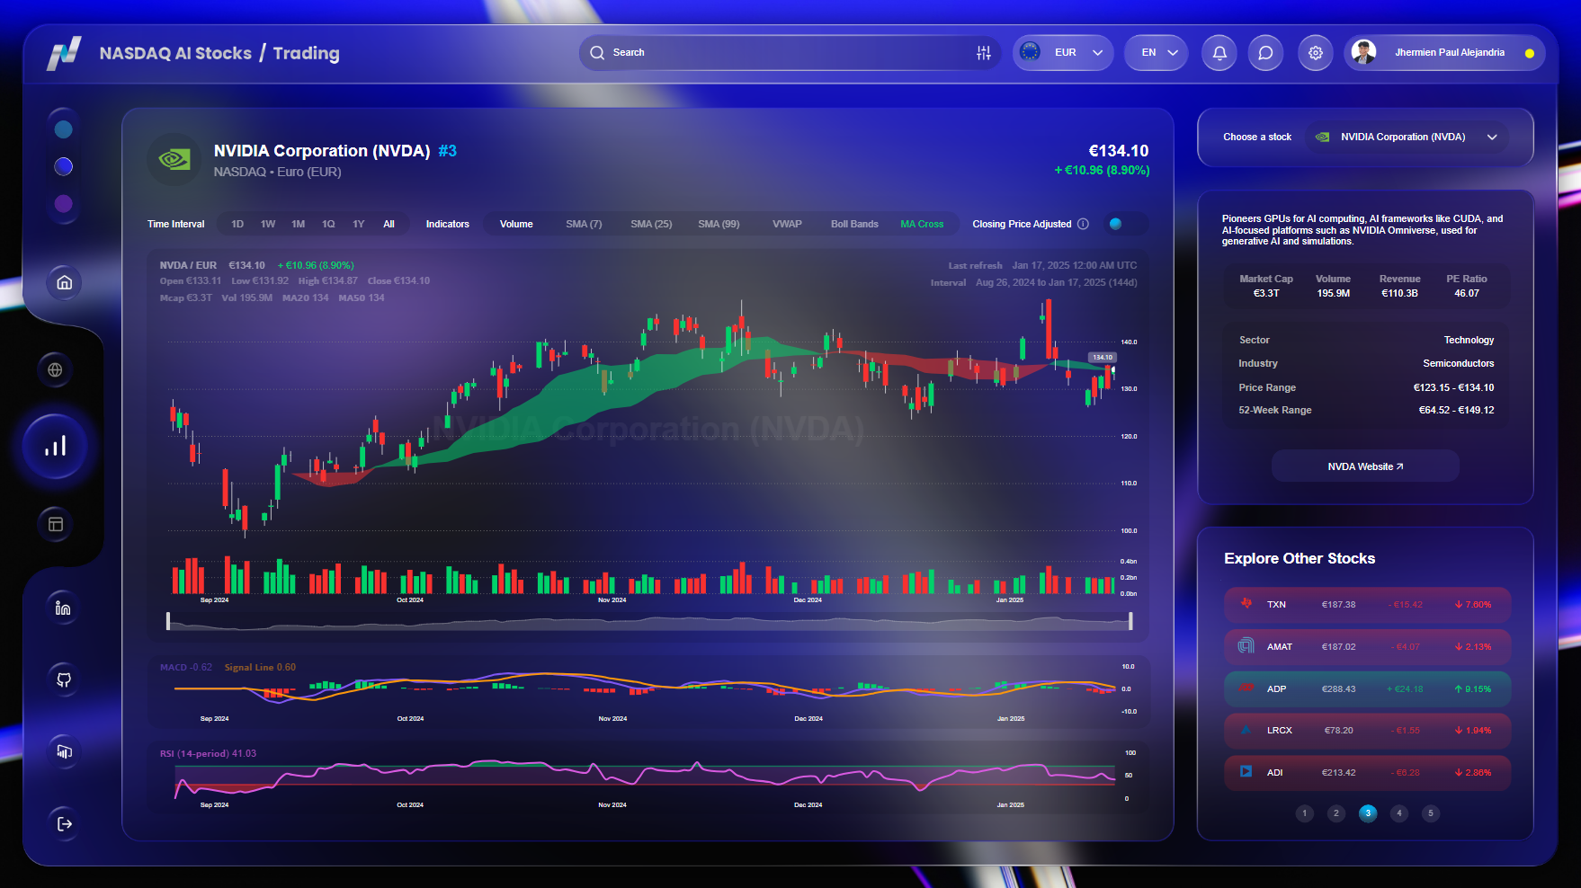
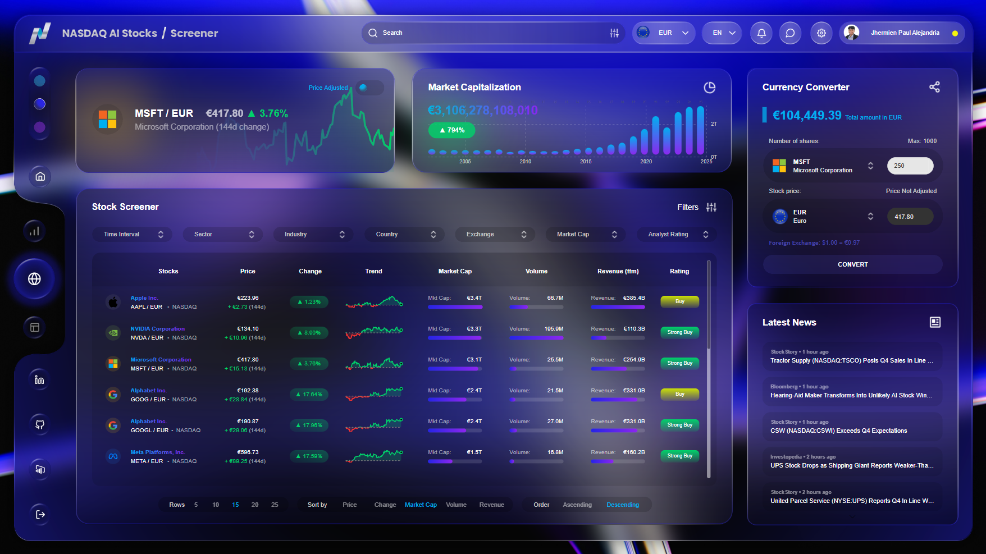
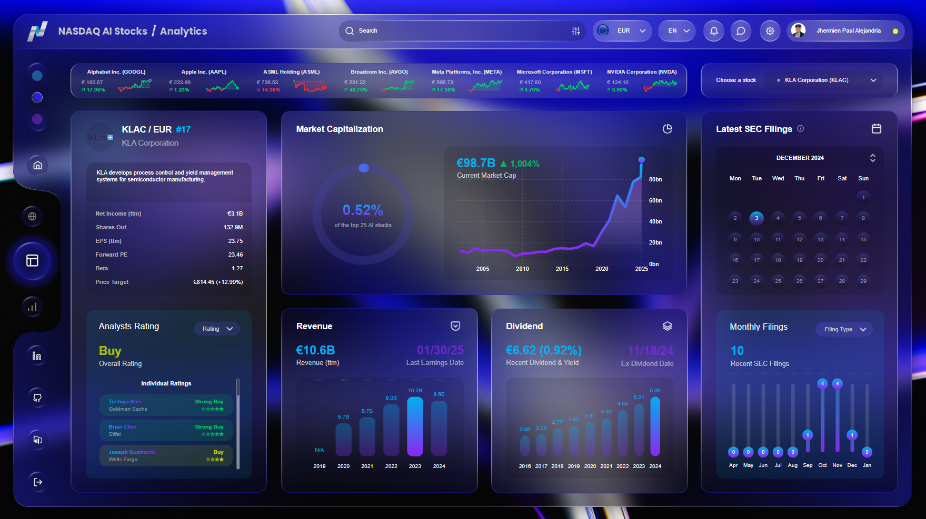





NASDAQ AI Stocks
AI-Powered Stocks
at Your Fingertips
Track and analyze the top AI-driven companies shaping the future
Navigate the AI stock market with our curated selection of 25 NASDAQ-listed companies pioneering artificial intelligence. Utilize advanced screening tools, technical indicators, and financial analytics to refine your investment strategy.
Home Screener Trading Analytics

Slide 2











NASDAQ AI Stocks / Screener

Slide 3
NASDAQ AI Stocks / Trading

Slide 4
NASDAQ AI Stocks / Analytics

Slide 5



Slide 6


